Slide 1
3 Digit Sequential Lock
A presentation by Junaid Ali & Amur Pal

Slide 2
Table of Contents
Project Title & Problem Statement 3
Project Specifications 4
Block Diagram 5
Work Division 6
Schematic 7
Design Steps 8
Simulation Snapshots 9
Applications 13
Future Recommendations 14
Conclusion 15

Slide 3
Project Title: 3 Digit Sequential Lock
Problem Statement:
Construct a 3-digit lock using sequential logic. Allow the user an option to store input or attempt an unlock. Design a counter that keeps track of wrong inputs and upon hitting 3, the buzzers hits and the system shuts down. Make sure to use flip-flops, comparator ICs, tri-state gates in your design.

Slide 4
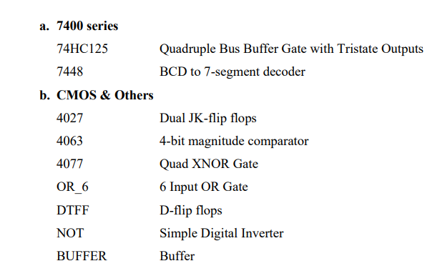
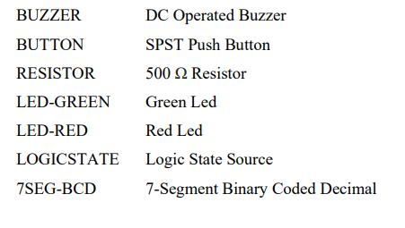
Project Specifications
1/24/2021
The lock has 3 decimal digits, so correspondingly 12 BCD bits. Input consists of these 12 BCD bits and a control input.
Output is displayed through LED indicators, a wrong input counter display and a buzzer.
Two levels of tristate gates are used to cut off the display upon key entry and to shut down the system upon 3 wrong inputs.
Data is stored in D-flip flops operating as registers.
The memory bits and current input is compared using three 4-bit magnitude comparator ICs (CMOS 4063).
A GUESS/RESET button is placed for the user to operate and test their inputs.
A counter is built using two cascaded JK-flip flops to keep track of wrong inputs.

Slide 5
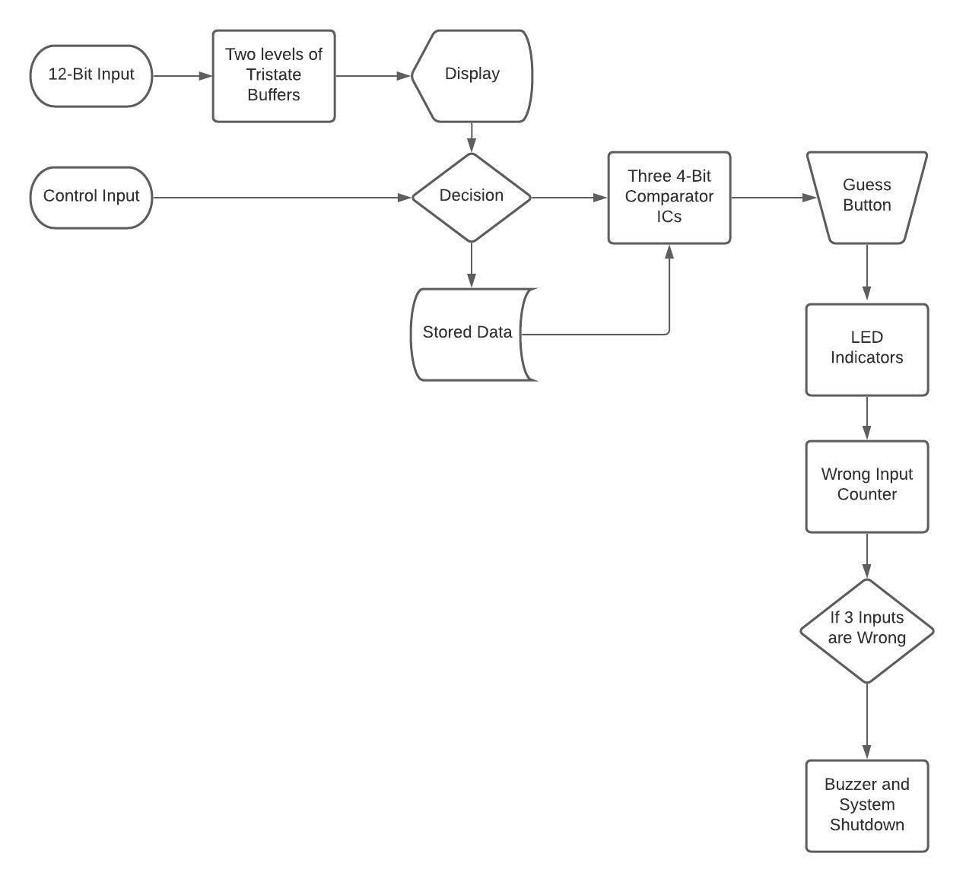
Block Diagram of the Project

Slide 6
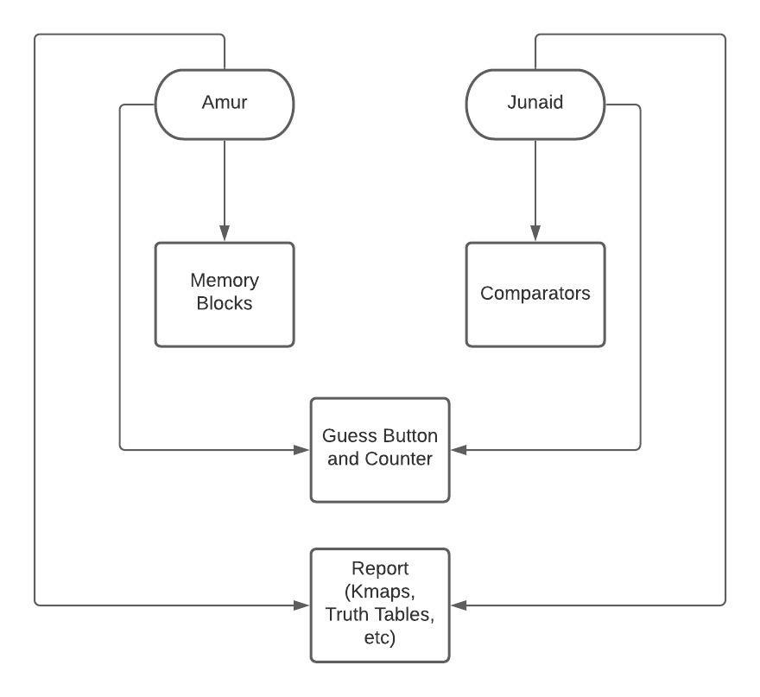
Work Division

Slide 7
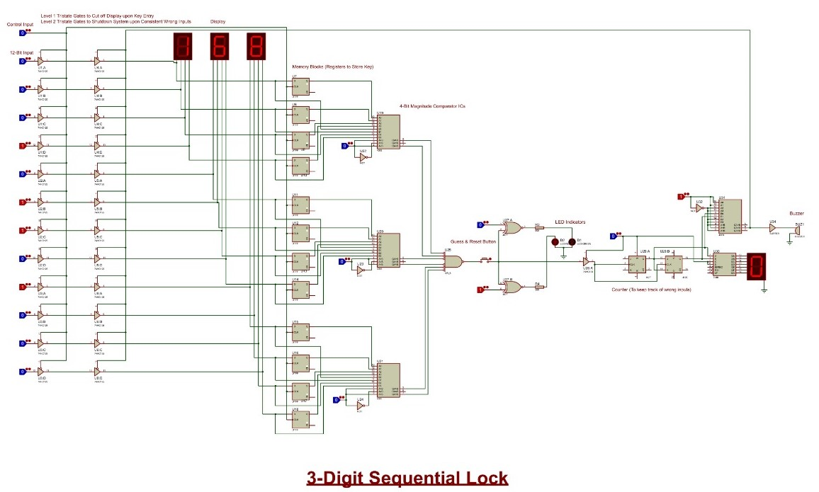
Schematic Diagram

Slide 8
Design Steps
First and foremost, we figured out how we can compare two numbers together, and following the principle of XOR comparators, we decided to use three 4063 ICs to serve as the main working chunk of our project.
Next, we wanted to introduce sequential logic concepts into the design, therefore we made use of D-flip flops to store the key to the lock, working as registers.
A multi-purpose control input was added to the circuit to cut off the display upon key entry using tristate buffers. The control input also decides whether the user wants to input the key or attempt to unlock the lock.
A GUESS/RESET button was installed so the user can test their input and following that were LED indicators that would light up (green for correct, red for incorrect) upon data entry.
Next a JK-flip flop counter was used to keep track of the number of wrong inputs and to give 3 warnings to the user. When this counter hits three, a buzzer rings and the system shuts down.
All access to the user is cut-off until the reset button is hit.

Slide 9
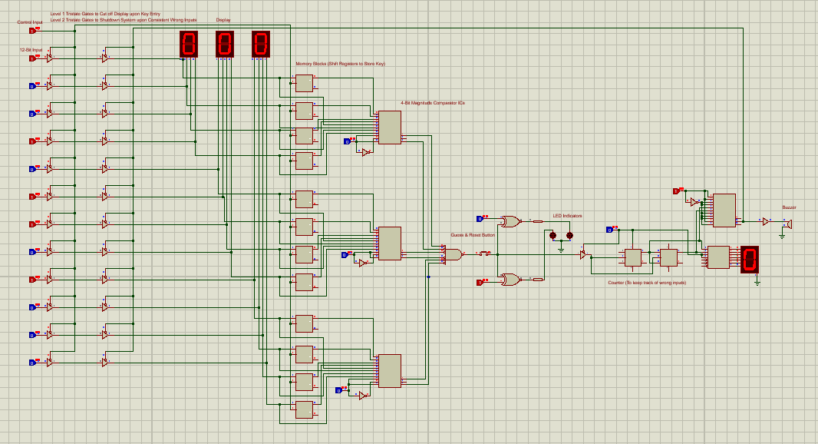
Simulation Snapshots
Entering Key

Slide 10
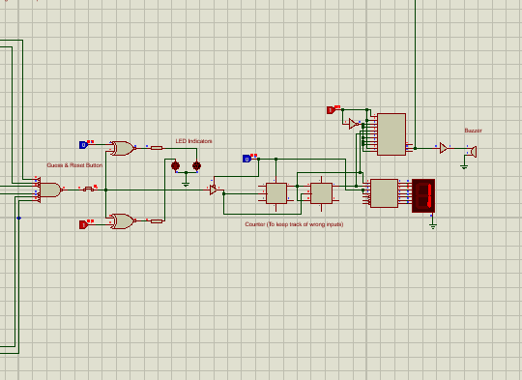
Simulation Snapshots
Wrong input is guessed
Entering Key
Entering Wrong Input

Slide 11
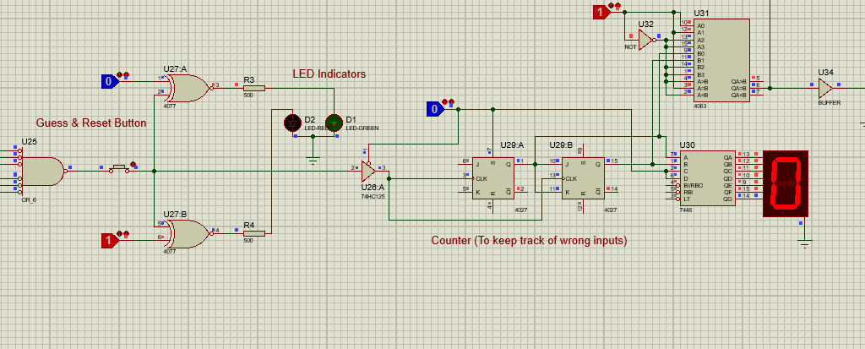
Simulation Snapshots
Entering Key
Correct input is entered

Slide 12
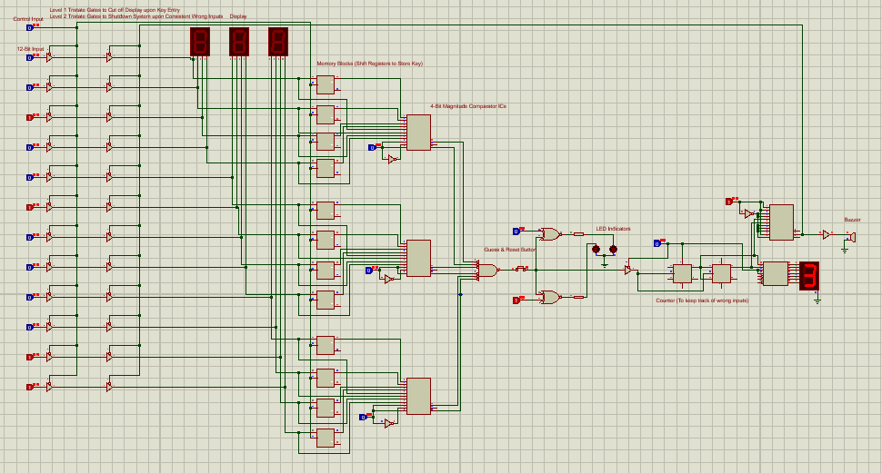
Simulation Snapshots
Buzzer runs and system shuts down
upon three wrong inputs
Entering Key

Slide 13
Applications
Basic Component of every digital security device
They are vastly used in school lockers
Home burglar Alarm
Wherever you require some sort of security that deals with numbers, this lock can be used

Slide 14
Future Recommendations
A separate display for key (that is turned on when required)
Different entry points for key and for user input
Segregating the Reset and Guess Button
Increasing the no. of wrong inputs
Implementation in hardware
Decimal input using keypad and a microcontroller
Design can still be made much simpler to eliminate propagation delay
Separate Control Panel, Comparator Unit, Counter, LED Indicators

Slide 15
Conclusion
All in all, this project has been a great learning experience for both of us. We implemented all the things we learned in the classroom into a circuit in the end to make it work.
Furthermore, we do believe this project has potential to find real life applications upon hardware implementation and slight improvements.
Any questions?

